Slide 1

World Happiness Report
Analysis of trend & influential factors
for next travel country recommendation
IE 6600- Sec 05- Project 02- Group 18
Yash Nema, Yanming Liu, Simran Bhatia

Slide 2

Agenda for today
What is the World Happiness Report?
What is its significance?
Breakdown of analysis
Outcome of analysis
Notes:
Change watermarked icon

Slide 3

Glimpse into the data How was the World Happiness Report created and what are its parameters?
1
Notes:
DAN

Slide 4




About the data
General stats
Happiness Score
Records
Range
Countries
4351x9
2015-19
145
2.85-7.77
Notes:
Change watermarked icon

Slide 5
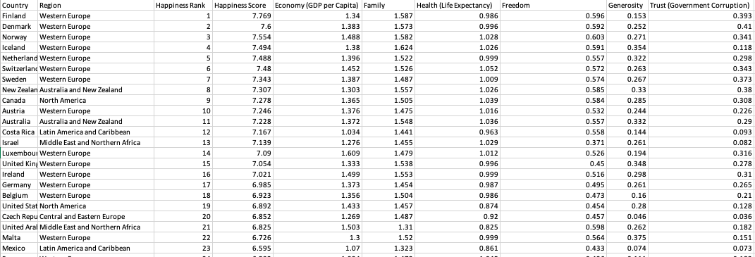
World Happiness Report Data
Country | Region | Happiness Rank | Happiness Score | GDP per Capita | Family Score | Life Expectancy
Freedom | Generosity | Trust/ Government Corruption

Slide 6

On to the
analysis

Slide 7
Overall Trends How has “Mental Health” Topic Search Intent varied with Happiness Score?
2
Notes:
DAN

Slide 8
Strong correlation can be seen between “Mental Health” Topic Search Intent and the Happiness Score

Slide 9
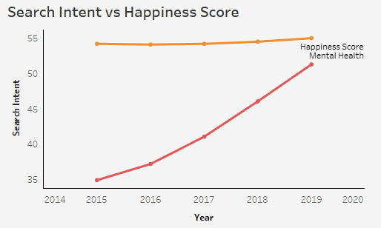
Are we talking about mental health and happiness enough?
Google Search Intent “Mental Health” Topic vs. Happiness Score
A frustrating fact
Search intent of mental health is increasing significantly and overall happiness score is sees a steady but slow growth. Efforts are being taken but progress is slow
Data Source: Google Search Trend and World Happiness Report
Notes:
Intro
With the increasing mental health awareness, the happiness scores improved on average as well. However, it’s a slow speed.

Slide 10
Overall Trends Is Happiness Score changing over the years?
3
Notes:
DAN

Slide 11
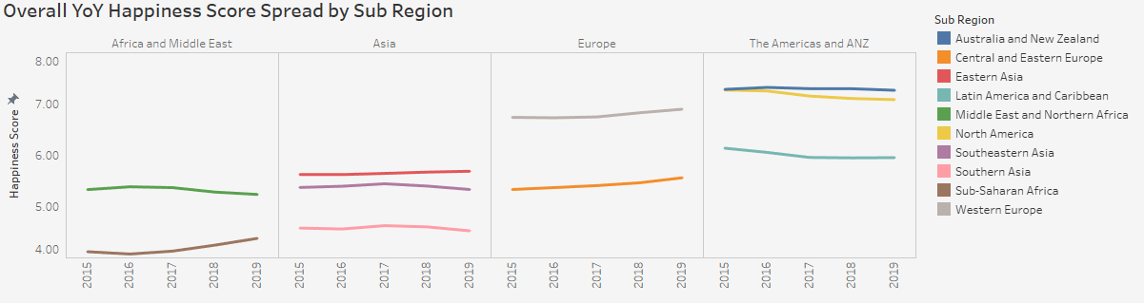
Is Happiness Score changing over the years?
Developed regions like Europe, North Americas and Australia have higher average Happiness Scores than developing regions like Asia and Africa.
Only European region, and Eastern Asia sees a rise in YoY Happiness score.
Data Source: World Happiness Report
Notes:
Intro
With the increasing mental health awareness, the happiness scores improved on average as well. However, it’s a slow speed.

Slide 12
Overall Trends How have countries performed on the Happiness Score card and what factors impacted their scores?
4
Notes:
DAN

Slide 13
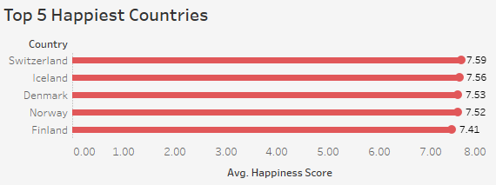
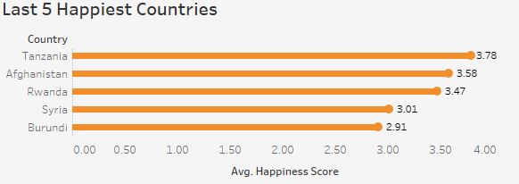
Which countries are most and least happy?
Switzerland ranks #1 on the average happiness score from 2015 to 2019.
Burundi is the least happiest country all over the world.
Top 5 Happiest Countries
Least 5 Happiest Countries
Data Source: World Happiness Report
Notes:
Intro
With the increasing mental health awareness, the happiness scores improved on average as well. However, it’s a slow speed.

Slide 14
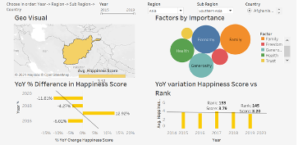
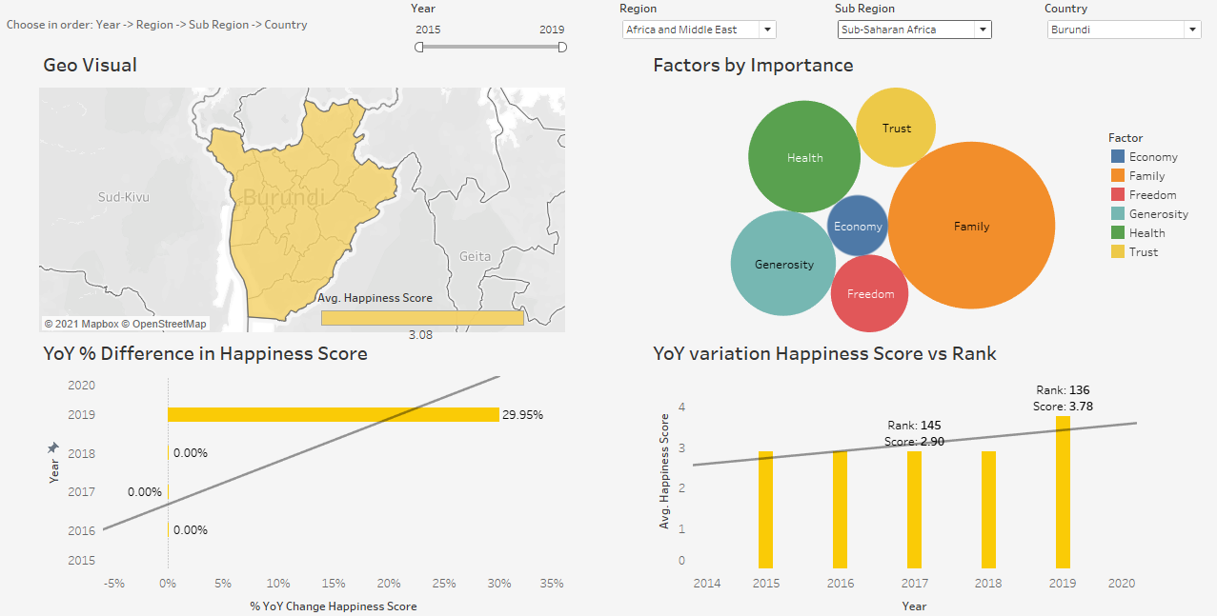
Example: Burundi
Data Source: World Happiness Report

Slide 15
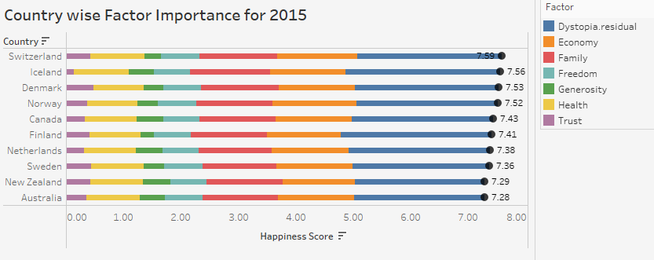
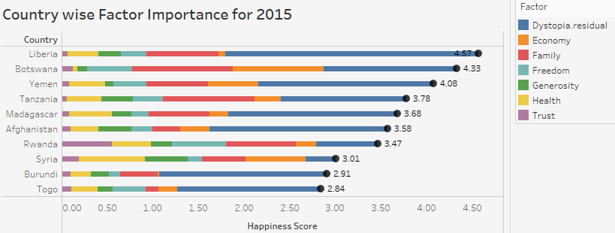
What factors contribute to happiness?
Most developed countries show higher contribution of economy while developing countries show higher contribution from Family and Health factors
Top 10
Bottom 10
Data Source: World Happiness Report

Slide 16
Deep Dive How are the 6 Factors impacting Happiness score related?
5
Notes:
DAN

Slide 17
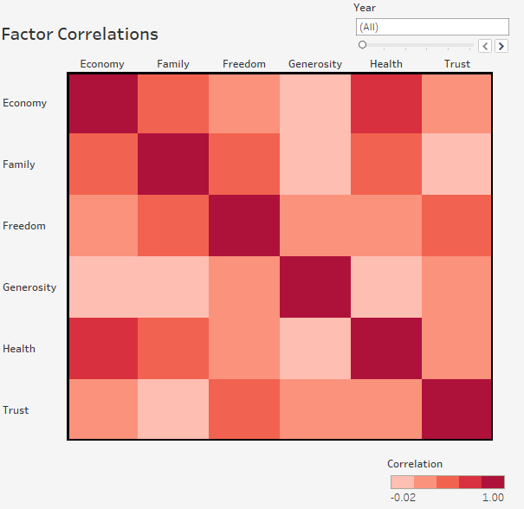
How much do these factors correlate?
Correlation between Factors remains similar across years.
Health is highly correlated with economy. This means, wealthy countries are more likely to be physically healthier.
Family is strongly correlated with health too.
Generosity doesn’t show correlation with economy, however, in a free and trusted environment people tend to be more generous.
Mental health matters more than material goods for generosity.
Data Source: World Happiness Report
Notes:
Also, three states are snipped here. All – highest correlation – lowest correlation.
Insights: for different years, the correlation share the similar trend. Also, trust are a bit correlated to freedom, but not that much.

Slide 18
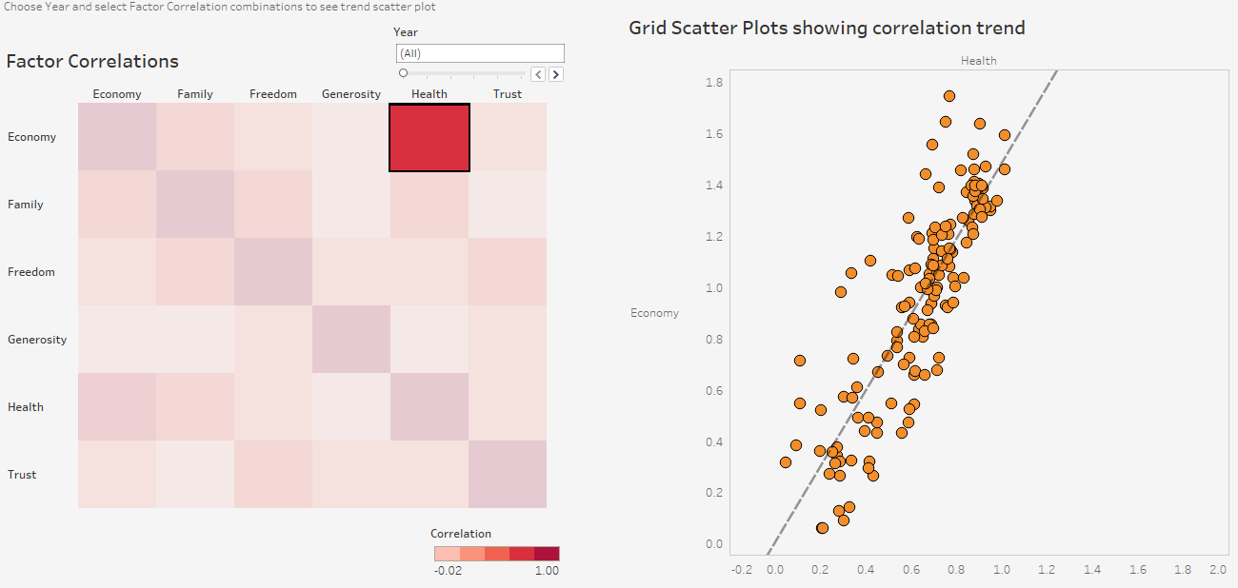
Correlation Between Factors
Data Source: World Happiness Report
Notes:
Health share a highest trend with economy. With an average value of 0.78 from 2015 to 2019. Wealthy people are more likely to be physical health. Also, family takes an import impact on people’s health.
Material + sprits works here.

Slide 19
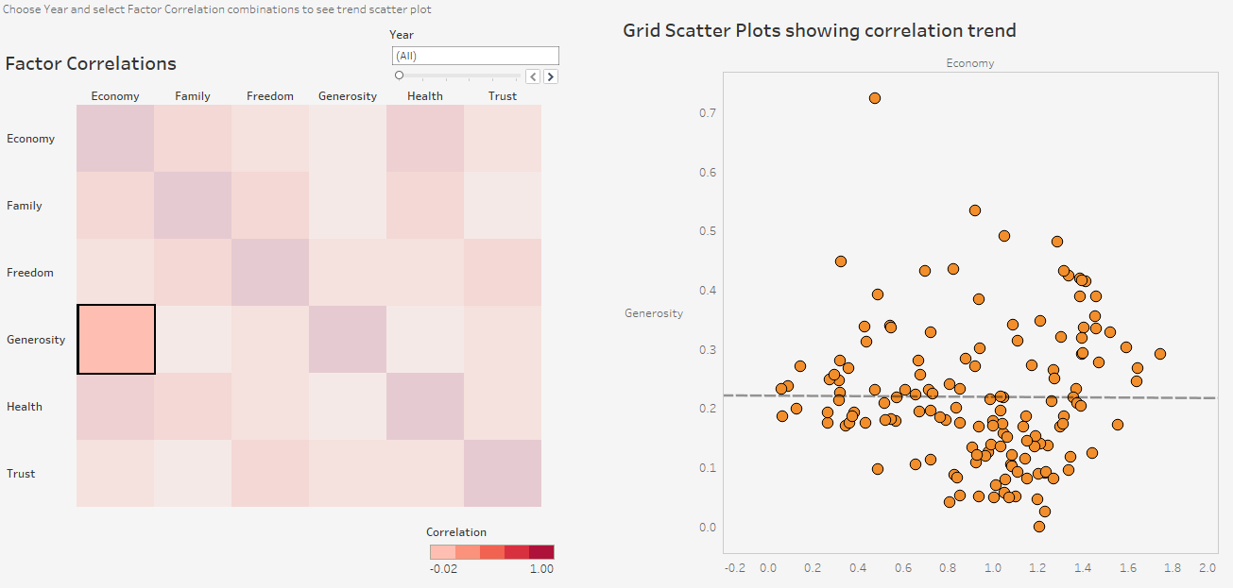
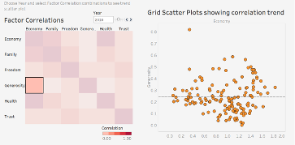
Correlations Between Factors
Data Source: World Happiness Report
Notes:
Generosity share no/less correlations with economy. However, in a free and trusted environment, people tends to be more generous. Inner Spirits may matter than material goods in generosity.

Slide 20
Next Travel Country Recommender How can we use the custom parameters to recommend which countries to visit?
6
Notes:
DAN

Slide 21
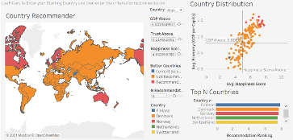
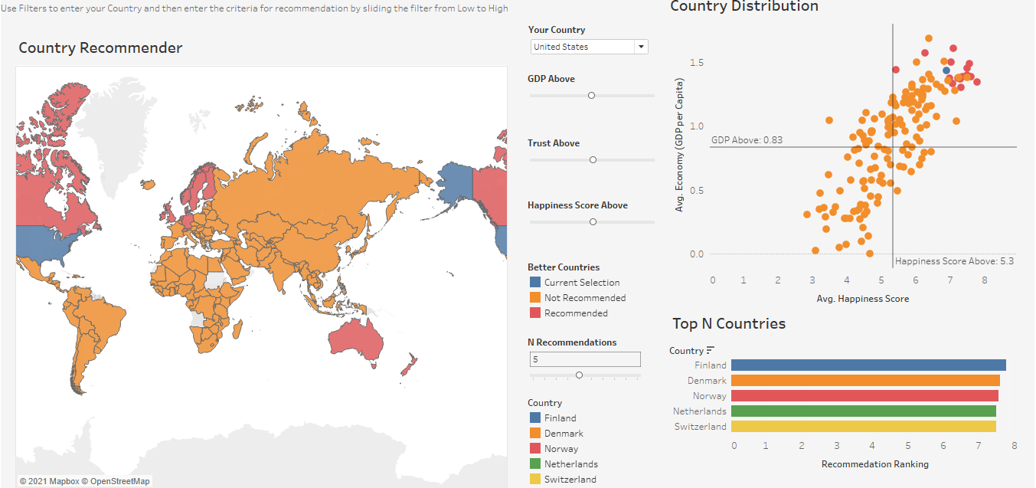
Planning your next trip? Let us help you!
Data Source: World Happiness Report
Notes:
Also, three states are snipped here. All with around average parameters– recommend countries – not recommend countries.

Slide 22
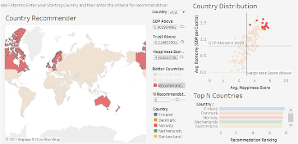
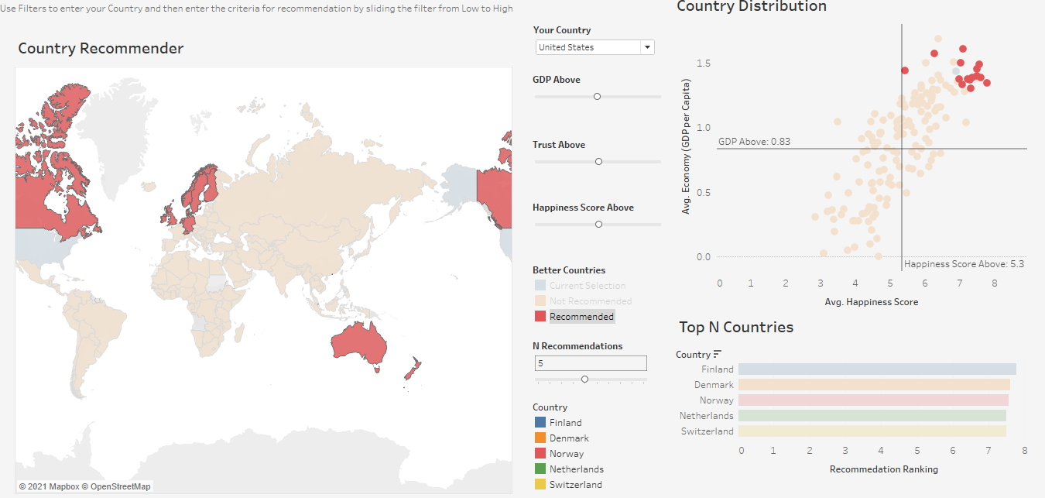
What countries we recommend
Data Source: World Happiness Report

Slide 23
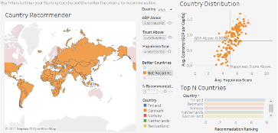
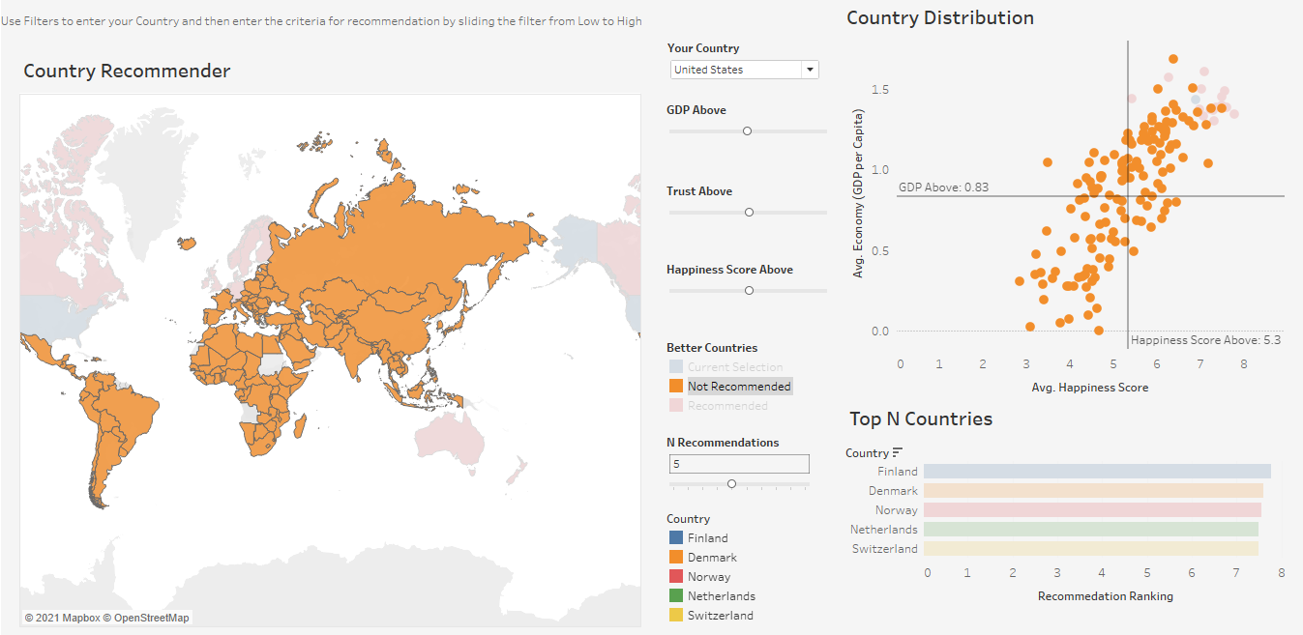
What countries are not recommended?
Data Source: World Happiness Report

Slide 24
Summary and Conclusion What are the Key takeaways?
7
Notes:
DAN

Slide 25
Summary
Mental health awareness is growing but happiness score is growing slowly. Progress is slow but steady.
Developing countries need to foster economy but developed countries should shift their attention to social and family support.
With more freedom comes more trust.
Health is closely related to material goods and wealth.
Generosity follows suit in countries with high freedom and trust scores.
Using parameters like GDP, trust, happiness scores, choose your next country to travel to.

Slide 26

The Happiness Score’s sweet spot is that we can successfully measure a countries growth not just by its GDP but also by factors like Family Relationships, Trust, Freedom, Health and Generosity that better represent the overall progress of the country

Slide 27
References
https://worldhappiness.report/ed/2021/
https://www.kaggle.com/unsdsn/world-happiness

Slide 28
QR Code: Group 18

Slide 29
Dashboard Snapshot
8
Notes:
DAN

Slide 30
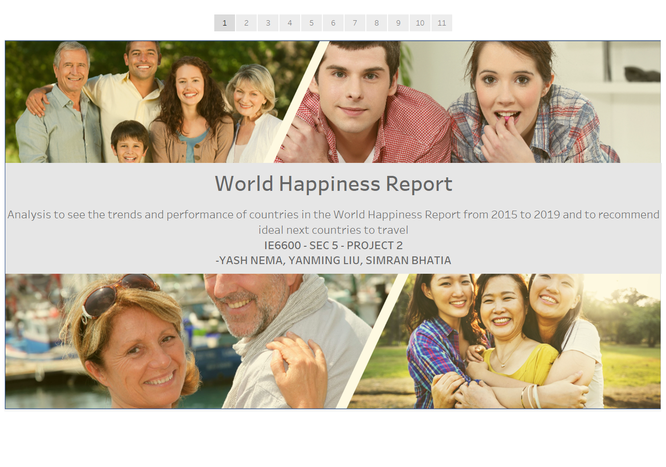

Slide 31
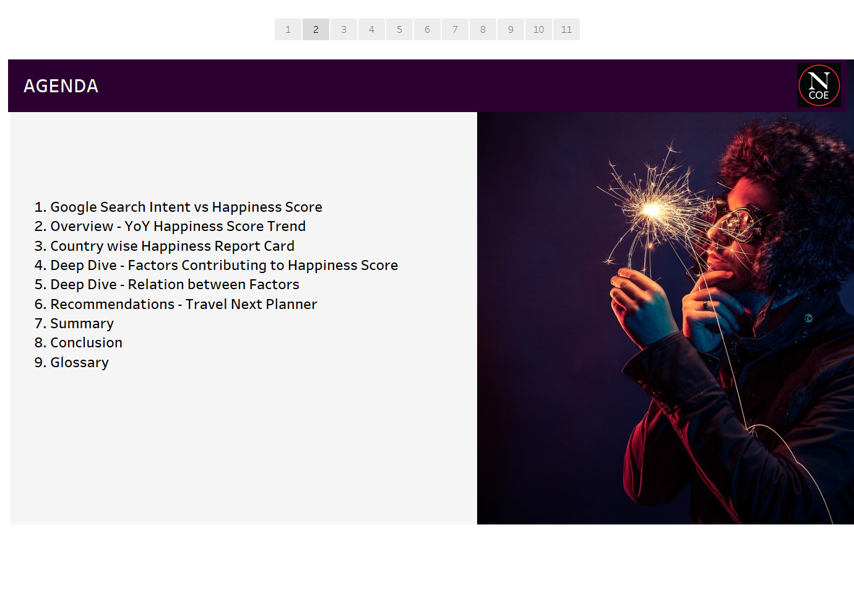

Slide 32
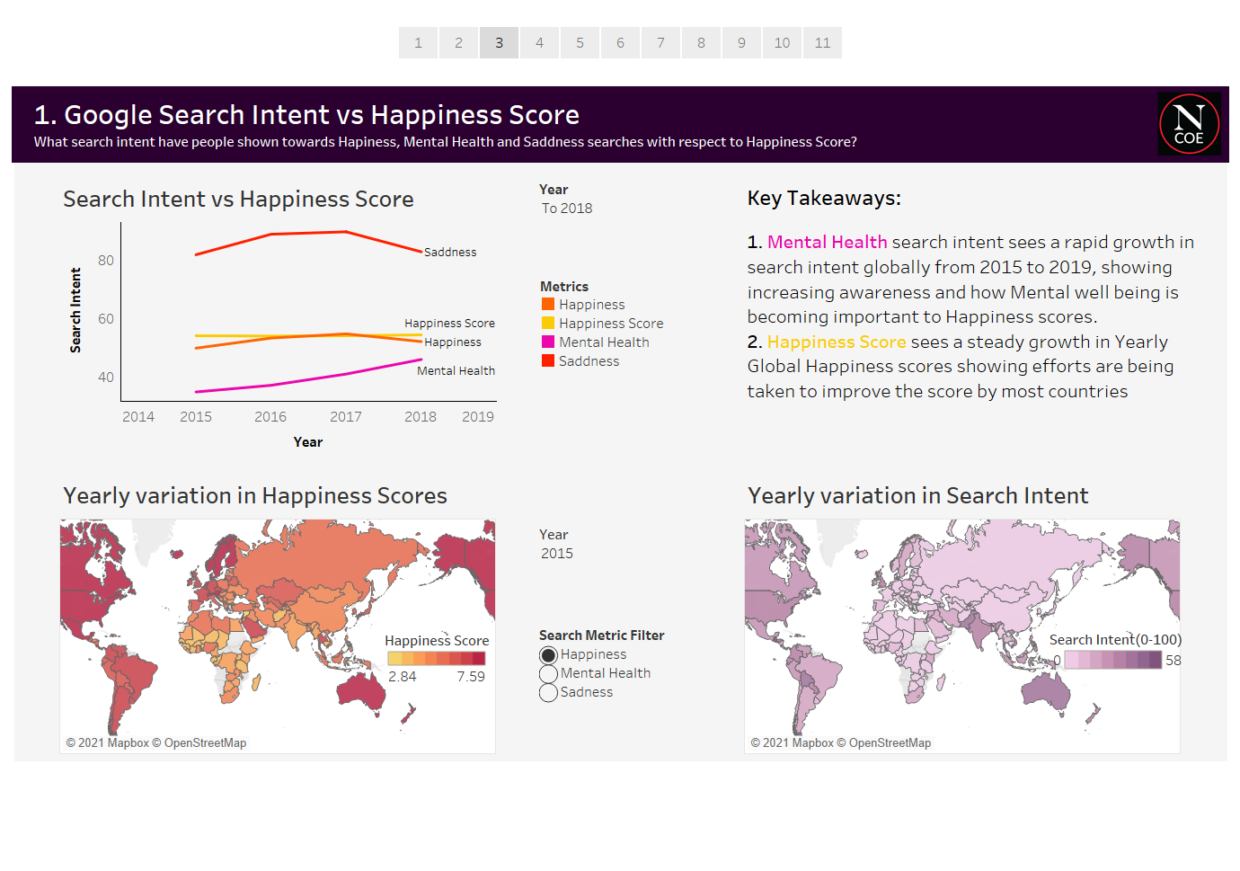

Slide 33
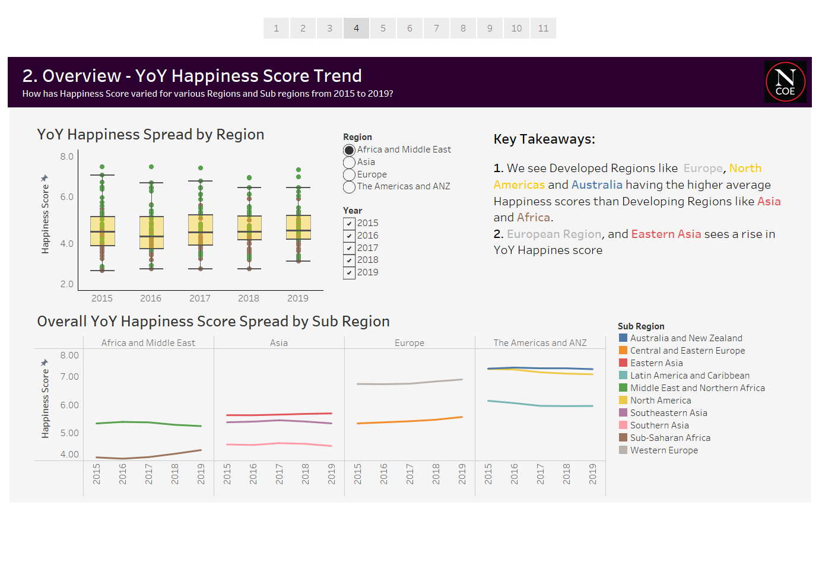

Slide 34
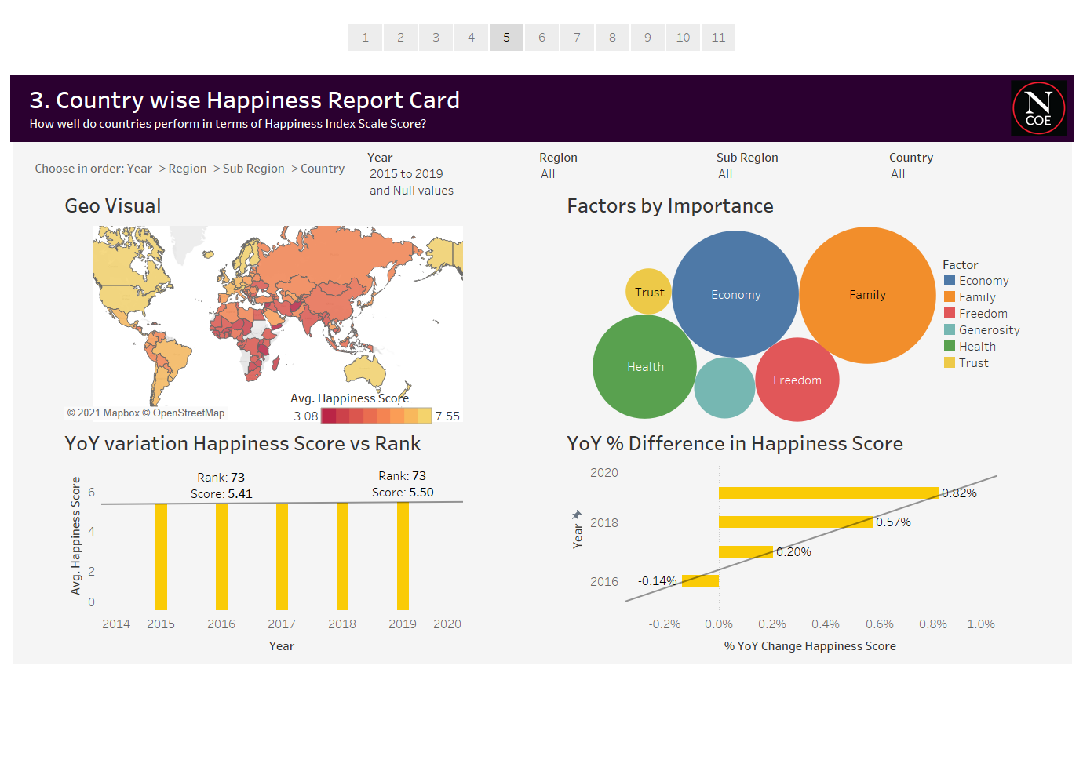

Slide 35
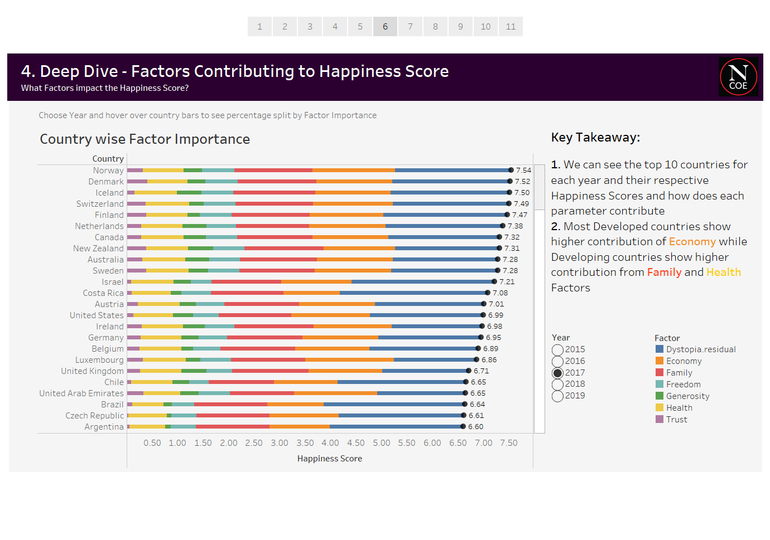

Slide 36
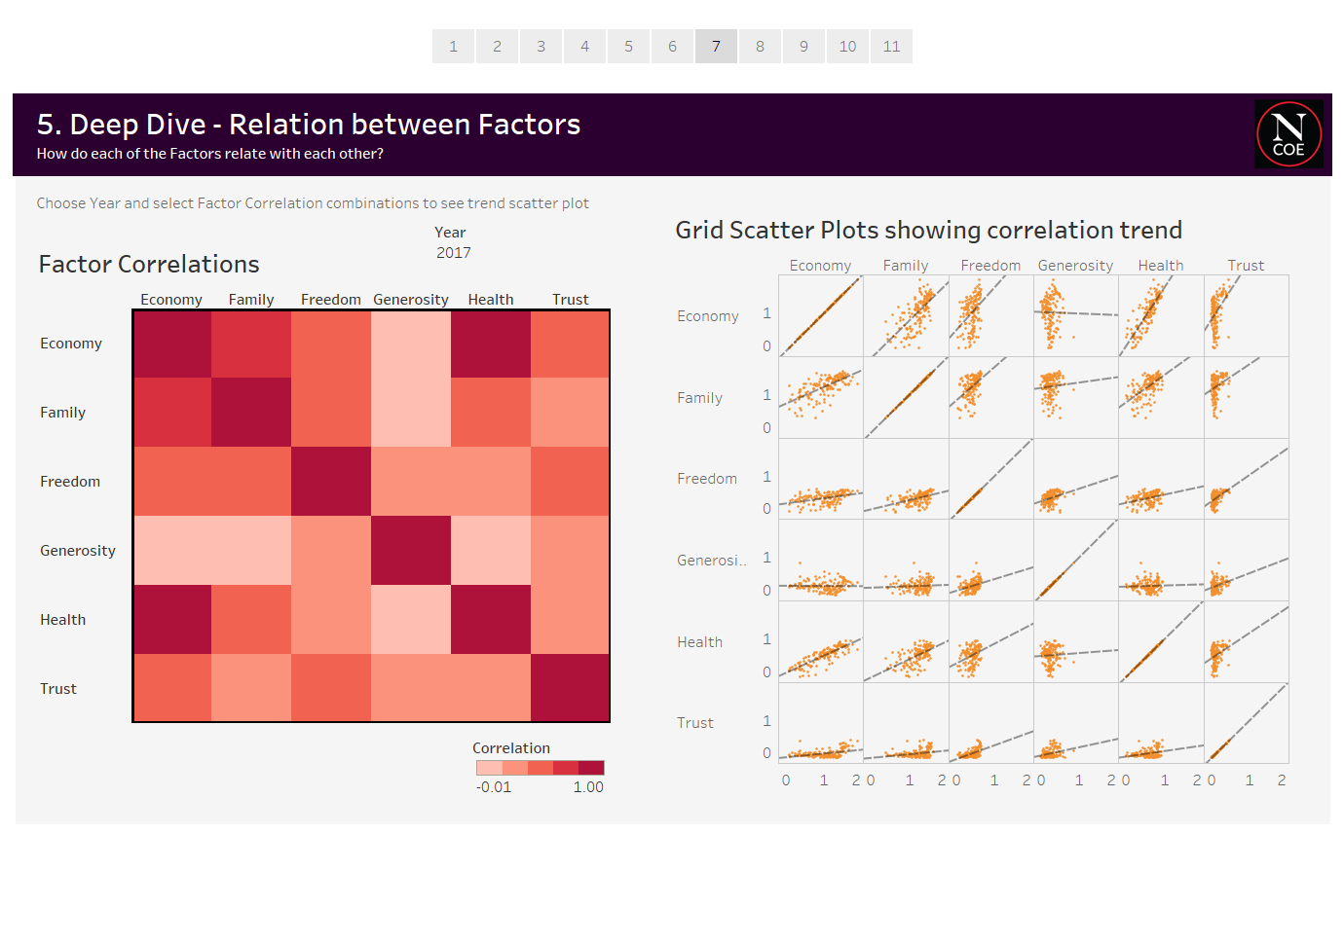

Slide 37
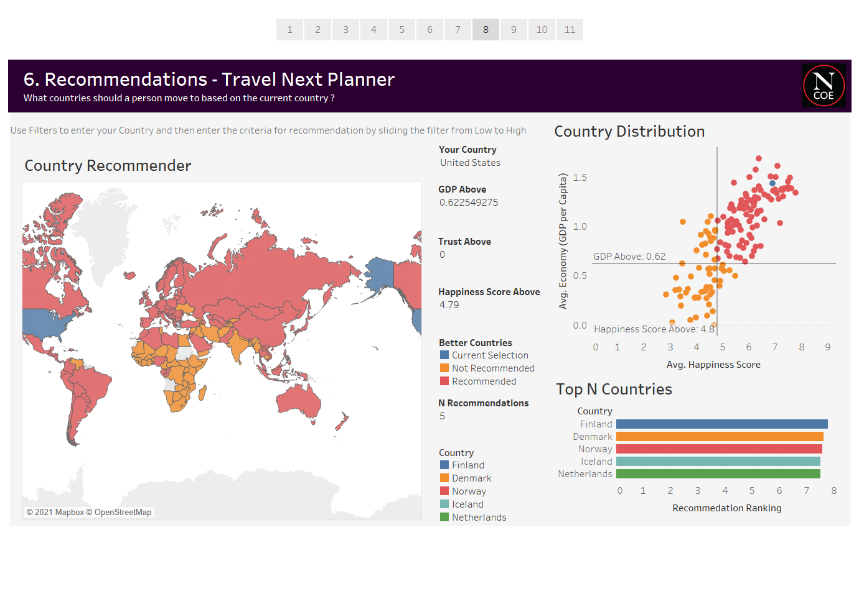

Slide 38
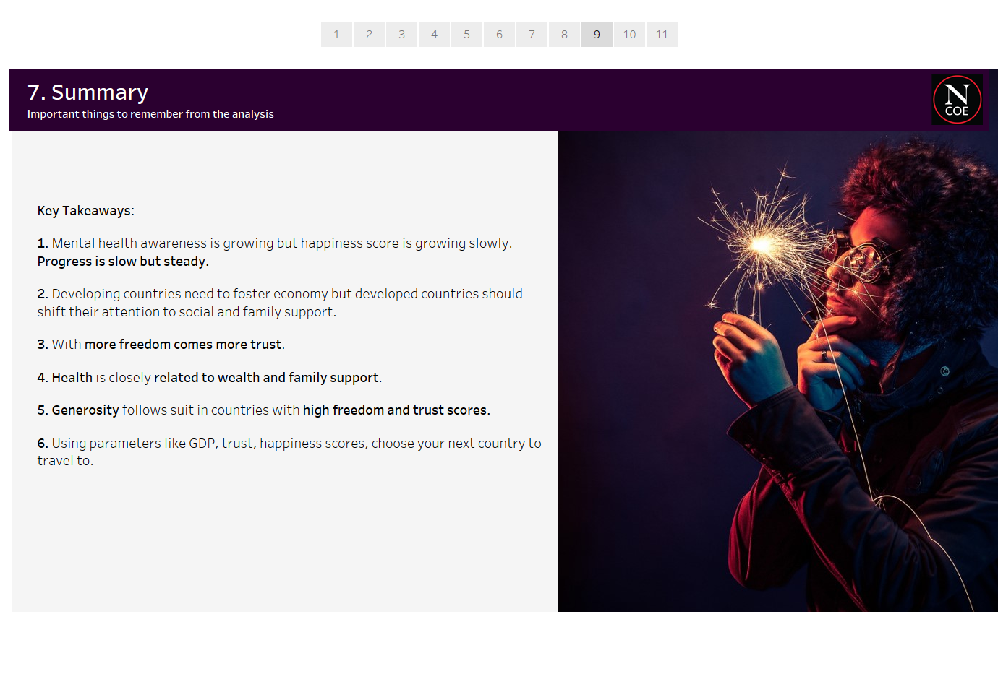

Slide 39
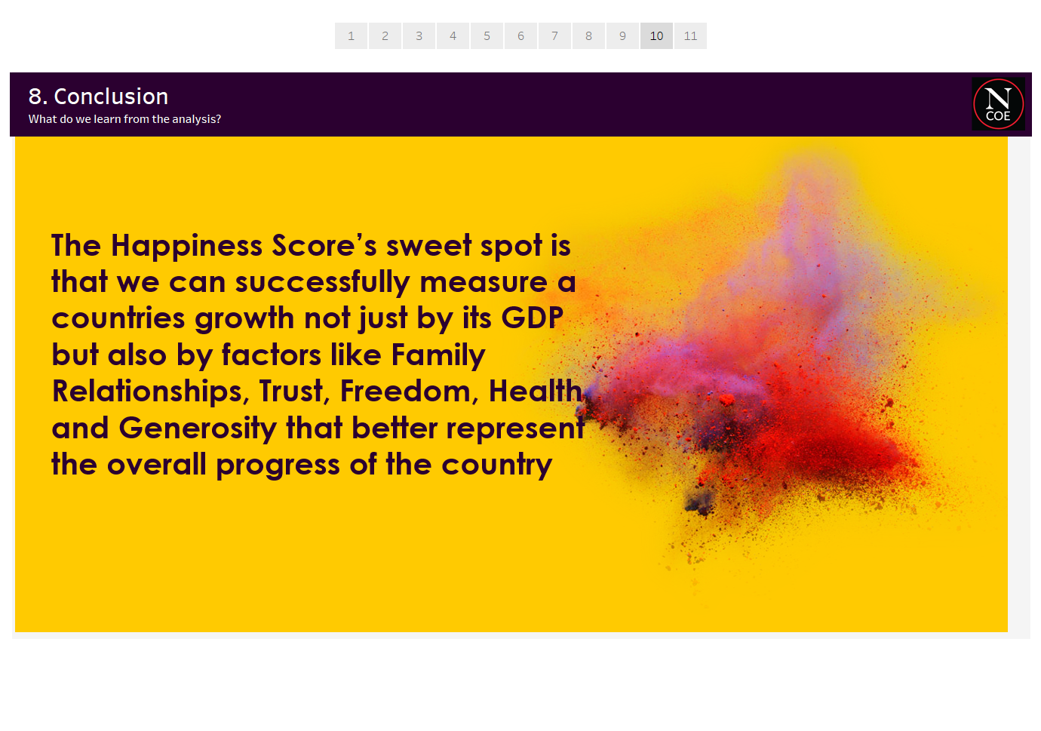

Slide 40
